Slide 1
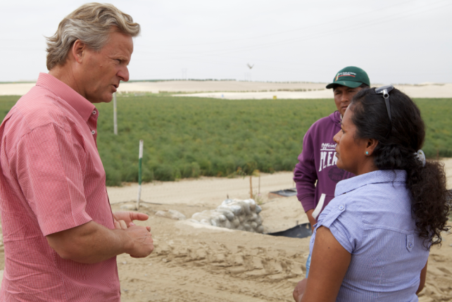
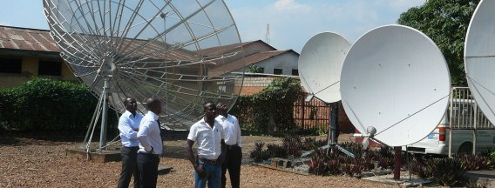
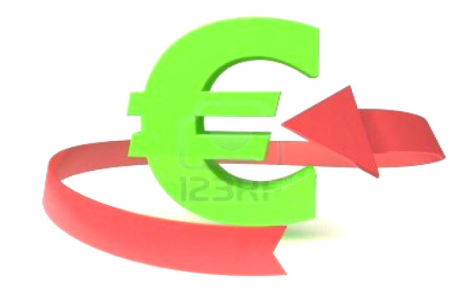
Dutch Good Growth Fund Finance for development

Slide 2
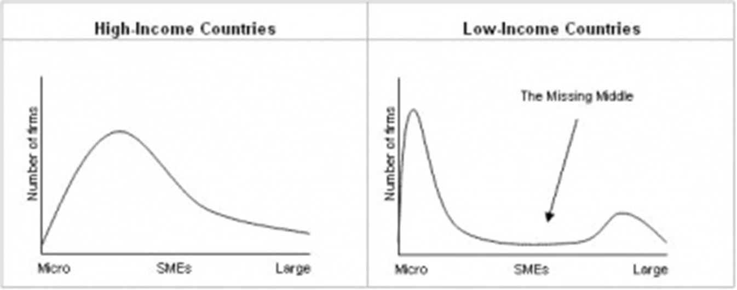
1. Introduction DGGF
Top priority in new Aid and Trade agenda
SME’s vital for job growth and economic development
But SME’s face financing difficulties (both in Europe and emerging markets)
DGGF Aims to alleviate shortage of capital availability for SME’s
Notes:
Gebrek aan kansen: ongelijkheid tussen mannen en vrouwen, bevolkingsgroei vereist creatie banen (vergeleken met 2005 moet in 2020 het aantal banen in sub-Sahara-Afrika met minimaal de helft zijn toegenomen om de officiële werkloosheid op hetzelfde niveau te houden.

Slide 3
2. Dutch Good Growth Fund
The DGGF (€700 million in total) is a revolving fund which offers tailored funding arrangements for entrepreneurs (particularly small and medium-sized enterprises) that have solid business or investment plans and relevance to development, and whose business practices are sustainable and socially responsible.
Investmentcapital of 700 million:
Year 2014 2015 2016 2017
Investmentcapital 50 100 250 300
Technical assistance: €70 mln (2014-2017)
DGGF country classification = PSD country classification

Slide 4
Financing will be available for:
Dutch SME’s wishing to invest in low- or middle-income countries;
Intermediaries who focus on SME financing in low- and middle-income countries
Dutch SME’s aiming to export to low- and middle-income countries.

Slide 5
Track 1: Dutch SME’s wishing to invest in DGGF countries
Fundmanager: RVO
Target group: NL SME’s
Investments up to €10 mln in the 66 DGGF countries
Tailormade financing;
Guarantees, loans, equity
Cooperation with local banks, NGO’s en Investment funds
Budget: €175 mln
Technical Assistence: €18 mln (2014-2017)

Slide 6
Track 2: Intermediaries who focus on SME financing in low- and middle-income countries
Target group: SME’s in DGGF countries
Fundmanager: Currently in a European tender procedure (contract 10-15 year)
Fund of Fund
Focus: 50% LICs, 15% Fragile/women/young entrepreneurs
Additionally
Seed Capital & Business Development budget: €26 mln (2014-2017)
Investment capital: €175 mln (2014-2017)

Slide 7
Track3: Dutch SME’s aiming to export to low- and middle-income countries
Fundmanager: Atradius DSB
Target group: NL/ Local SME’s
Transactions up to €15 mln
Exportcredit insurance
Direct financing
Budget: €175 mln
Technical Assistence: €9 mln (2014-2017)

Slide 8
3. Criteria
Each DGGF transaction will contribute to Development:
jobs
productivity
knowledge
Special care for Fragile/women/young entrepreneurs
CSR(OECD Guidelines/ IFC Performance Standards)

Slide 9
The end

